Slide 1
CUNY Helps

Slide 2
What problem are we addressing?
Providing at risk CUNY students with information and services to get ahead.

Slide 3
What does at risk mean?
At risk is a broad term used to define a person who is less likely to transition into adulthood.
This can be caused by a number of things including:
Poverty
Legal Trouble
Mental Health Issues

Slide 4
How did we solve the PROBLEM?
We have created a website that will serve as a hub for services provided to CUNY students that serves those issues.

Slide 5
PROGRAMS OFFERED
CUNY SINGLE STOP PROGRAMS
EMERGENCY LOANS AND GRANTS PROGRAMS
LEGAL AID SOCIETY

Slide 6
Food Pantry
Queens College
Office of Student Development & Leadership
65-30 Kissena Blvd., Flushing, NY 11367 Student Union, Room 327
Mondays, Wednesdays: 9:00am - 8:00pm
Tuesdays & Thursdays: 9:00am - 5:00pm
Fridays: 9:00am - 5:00pm
LaGuardia Community College
Room C-107
Monday, Thursday 9:00 a.m. – 7:00 p.m.
Tuesday, Wednesday 9:00 a.m. – 5:00 p.m.
Fridays: 9:00 a.m. – 1:00 p.m.

Slide 7
Food Pantry
Lehman College
Student Life Building, Room 120
Mondays: 4:00PM - 8:45 PM
Wednesday & Thursday 10:00 AM - 4:00 PM
John Jay College of Criminal Justice
Mondays: 10 am to 3:30 pm
Tuesdays: 10 am to 2:30 pm
Wednesdays: 10 am to 6 pm
Thursdays: 10 am to 3:30 pm

Slide 8
Health Services
CDC National HIV and AIDS Hotline
1800 - 342-2437
Alcohol and Drug Helpline
1800 - 821-4357
National Youth Crisis Hotline
1800 - 448-4663
Food and Hunger Hotline
866 - 888-8777

Slide 9
What impact do we expect it to have?
By offering these services, CUNY Helps can provide a prospering environment to ensure students can focus on being students.
Will directly increase graduation rates
Will increase job opportunities

Slide 10
Who is our target audience?
CUNY Students
Low Income Families
People who are homeless

Slide 11
What challenges did we run into and what did we learn?
Connecting our front end code to our back end code
We began to use Google’s Firebase in order to:
Authenticate users
Database to safely store user specific data

Slide 12
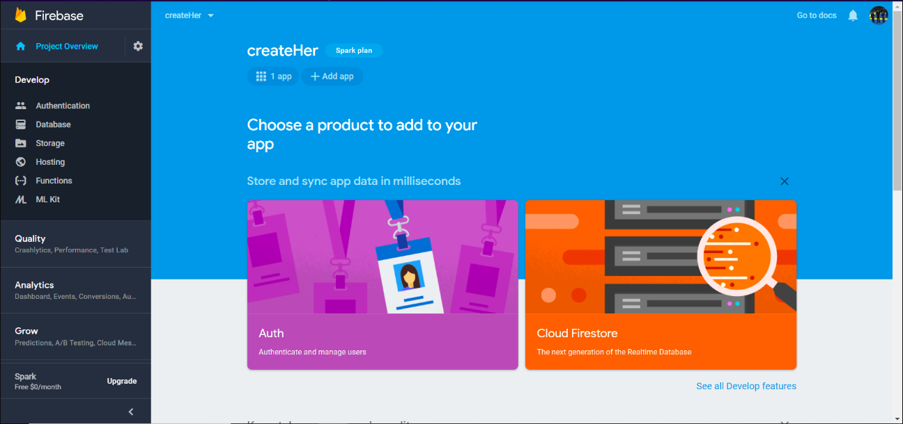

Slide 13
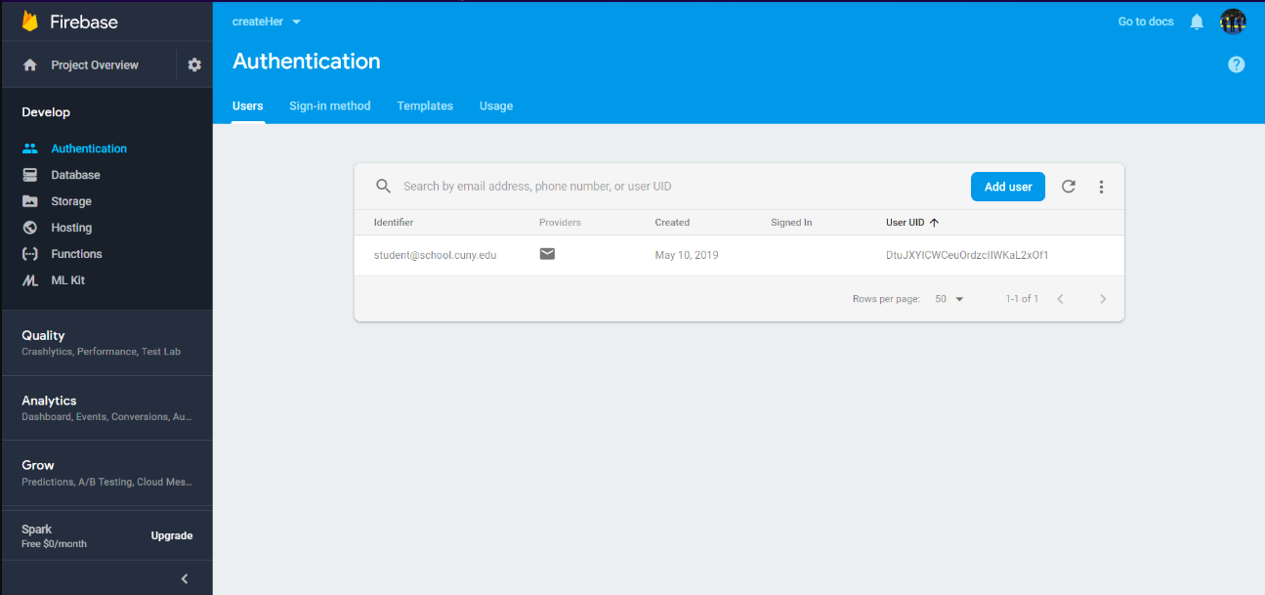

Slide 14
What’s next for our product/service/app?
Partnerships with small businesses
Can offer discount for students
Partnerships with post degree students
Students that need field requirements for graduation can complete hours with CUNY Helps
Expand to SUNY colleges

